Slide 1
RPI Foodies
Terry, Ryan, Veevek, Jackson, Jordan

Slide 2
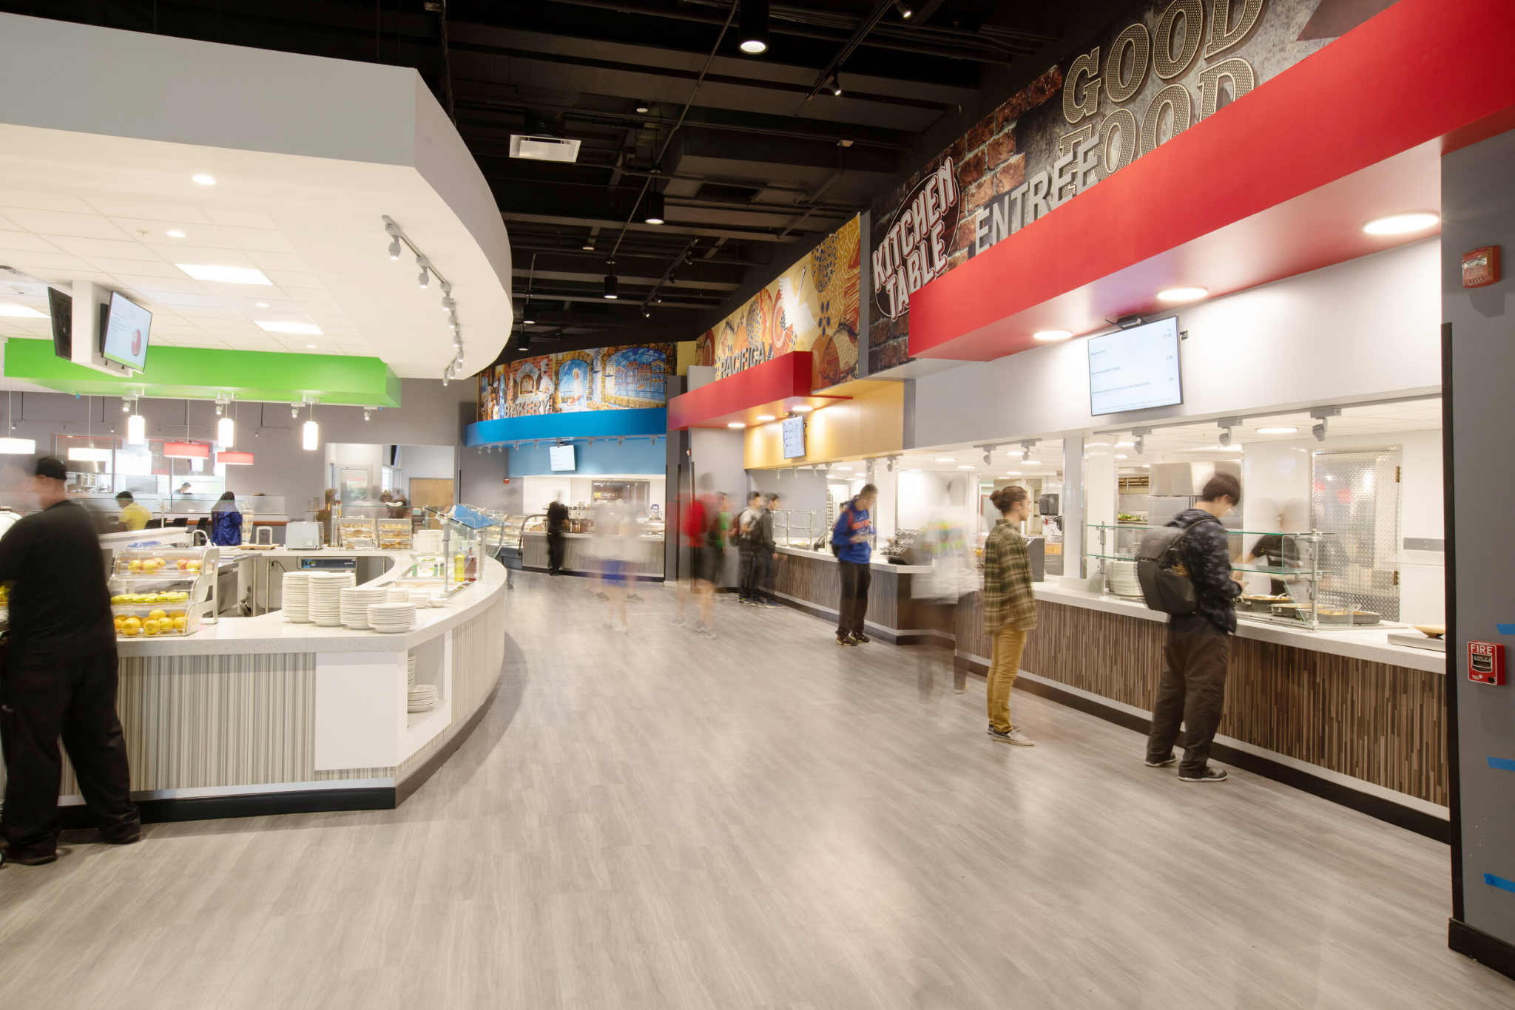
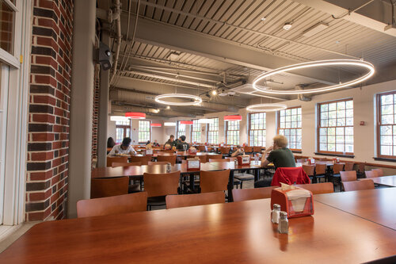
RPI Dining Halls

Slide 3
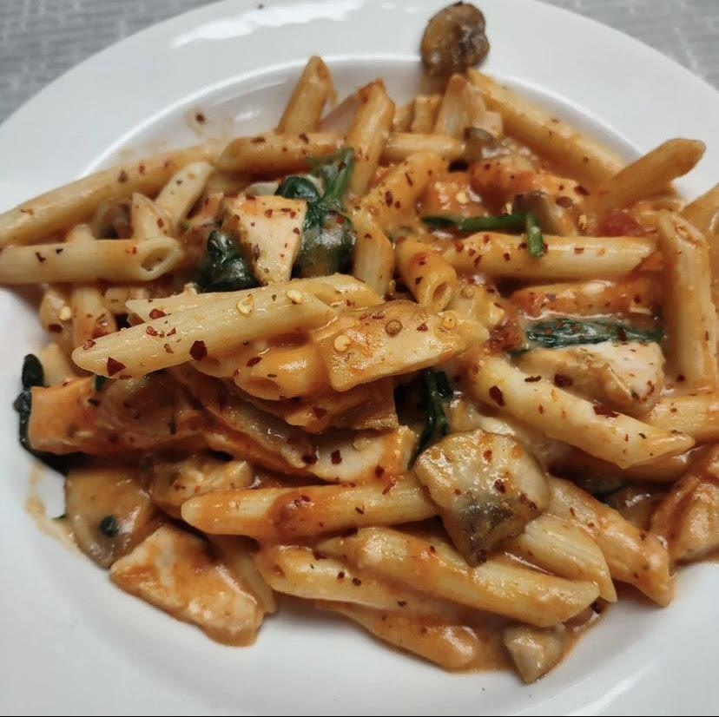
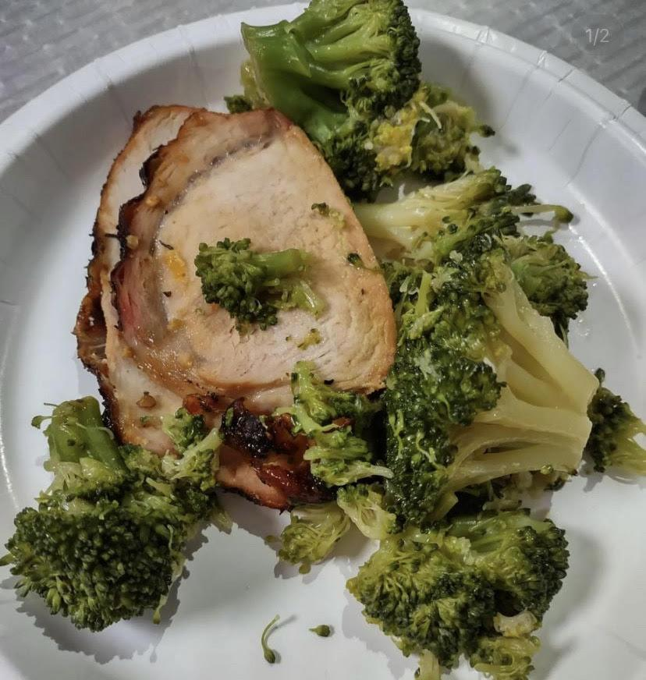
What is RPI Foodies?
Social media app to share dining hall food
Post like and comment RPI served food
Find a specific food or see what each dining hall is serving

Slide 4
Users and Stakeholders
Students of RPI
Users
Parents of Students
Stakeholders
Sodexo
Stakeholders
Rensselaer Dining
Users
RPI Clubs
Users
Rensselaer Admins
Stakeholders
Local Farmers
Stakeholders

Slide 5
Site Features
Instagram + Reddit
Each post will have a picture + rating scale
Reactions - likes, emojis and comments
Popular page - trending posts
Categories
Vegetarian/Vegan, Desserts, etc
Login/Create-account page

Slide 6
Technologies
Front End
HTML
Structure page layout + components
CSS
Style each component
Javascript
Add functionality
Back end
mySQL
Store data about users, posts, etc.
PHP
Communicates with front-end
analyze and rank user likes and comments
find the most popular foods and eateries

Slide 7
Functional and Non-Functional Requirements
Functional requirements:
Post pictures
Review posts
Backend data collection
Non-functional requirements
Sort by recent / search queries,

Slide 8
SiteMap

Slide 9
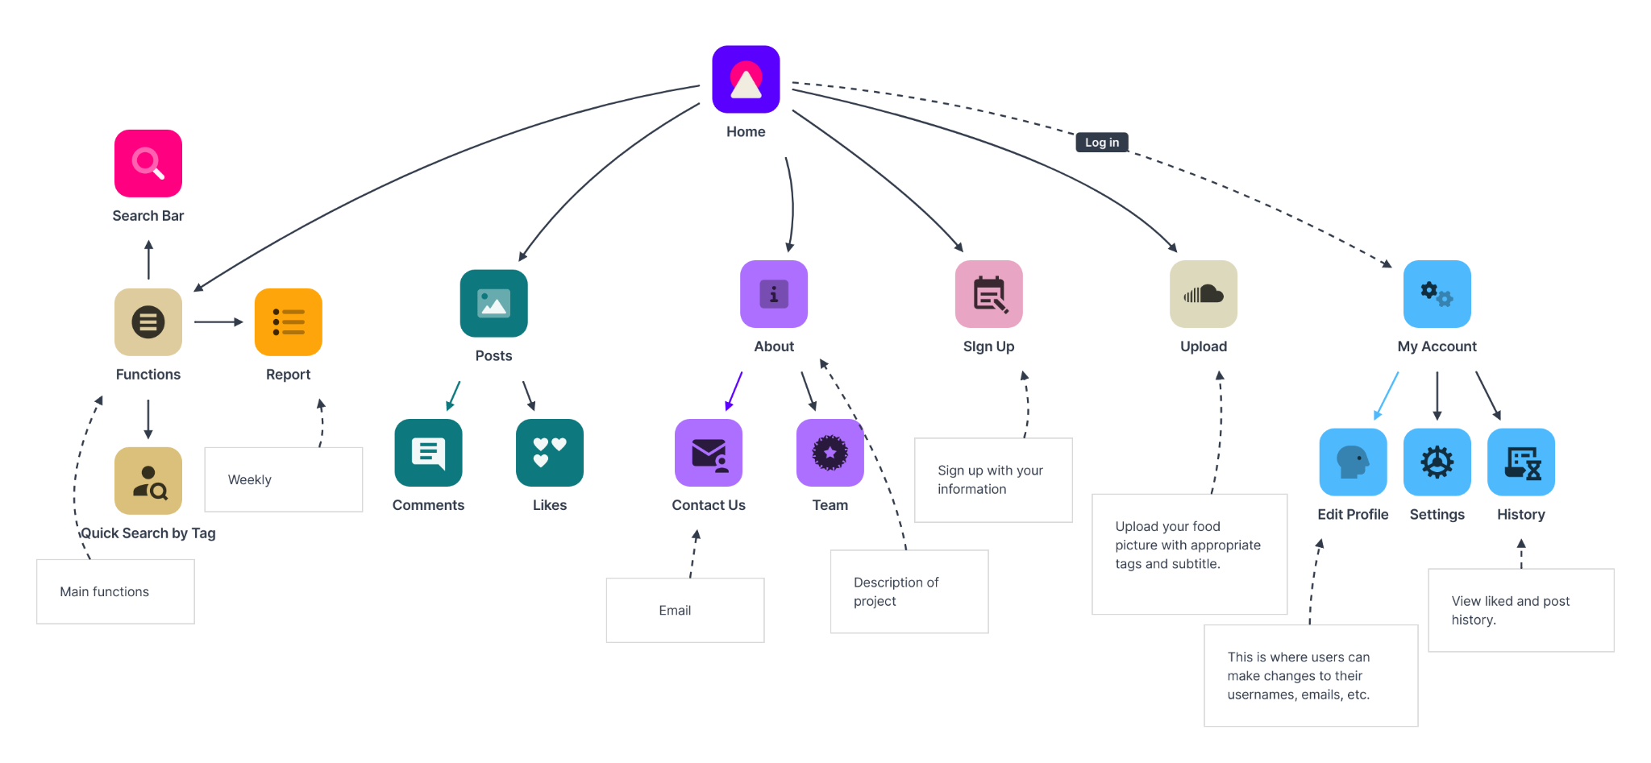

Slide 10
WireFrames
https://abhlyb.axshare.com/main.html

Slide 11
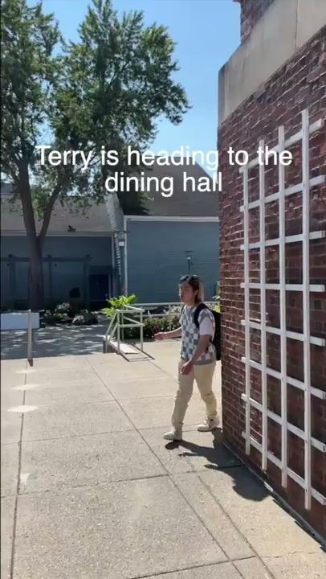
Tiktok

